Slide 1


Explainability in Clustering Algorithms
A Survey Paper with Experimental Results
RDKDD
24.06.2025
by Srujana Konduri

Slide 2


Explainability
Explainability in clustering refers to the ability to understand, interpret, and trust the decisions made by a clustering algorithm

Slide 3
What makes it... trustworthy?
Visual Intuition
Can we see it making sense?
Performance Metrics
Does the numbers add up?
Explainability Metrics
Can we understand the ‘why’ behind the clustering?

Slide 4
Categorization of Mechanisms
Intrinsically Interpretable Methods
Rule-Based and Logical Approaches
Post-hoc Explanation Methods
Constraint-Based Approaches
Visualization-Driven Methods

Slide 5

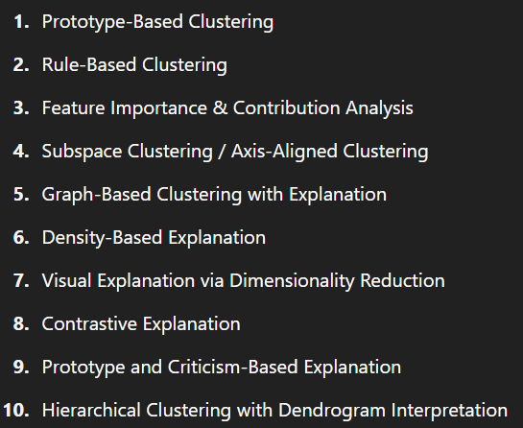
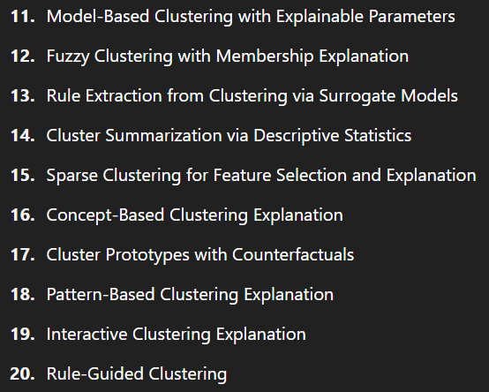
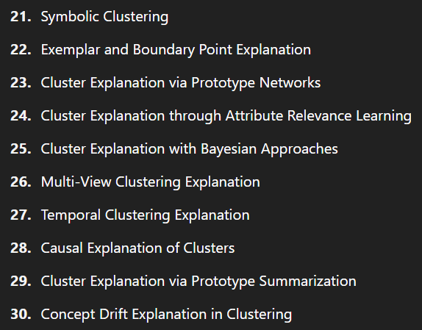


Slide 6
Chosen Methods
Intrinsically Interpretable
K-Means
Mini-Batch K-Means
K-Medoids (PAM)
Agglomerative Clustering
Ward Linkage
BIRCH
DBSCAN
OPTICS
HDBSCAN
Spectral Clustering
Gaussian Mixture Models (GMM)
Bayesian GMM (BGMM)
Post-Hoc Explanation Methods
LIME
SHAP
TreeExplainer / ICDT
ICE/ALE
Xclus
MUSE
Clust-Ex
ExCAPE
DICE
ProtoDash
Notes:
I focused on intrinsically interpretable and post-hoc methods because they represent the two main, practical approaches to explainability: one builds in transparency from the start, and the other helps explain powerful but complex models after clustering.
K-Means – Uses cluster centroids; easy to interpret distances.
Mini-Batch K-Means – Faster version of K-Means, still interpretable.
K-Medoids (PAM) – Uses real data points as cluster centers (more intuitive).
Agglomerative Clustering – Builds a hierarchy; explainable through dendrograms.
Ward Linkage – A type of agglomerative that minimizes variance; hierarchical explanation.
BIRCH – Uses tree summaries; good for large datasets with interpretable structure.
DBSCAN – Clusters based on density; clear rules for core/border/noise points.
OPTICS – Like DBSCAN but handles varying densities; explained via reachability plots.
HDBSCAN – Hierarchical version of DBSCAN with stability scores for explanation.
Spectral Clustering – Uses graphs and eigenvectors; somewhat interpretable via graph structure.
Gaussian Mixture Models (GMM) – Probabilistic; explains clusters with mean, variance, and weights.
Bayesian GMM (BGMM) – Adds uncertainty estimates; interpretable through distributions and priors.
LIME for Clustering – Builds local interpretable models around each point.
SHAP for Clustering – Uses Shapley values to show feature importance for assignments.
TreeExplainer / ICDT – Builds decision trees to explain cluster assignments.
ICE/ALE – Shows how changes in a feature affect cluster assignment.
XClus – Generates rules and summaries post-clustering.
MUSE – Provides multi-modal explanations (text, visuals, statistics).
Clust-Ex – Explains why a point is in one cluster and not another (contrastive).
ExCAPE – Uses prototype examples to explain clusters.
DICE for Clustering – Shows what changes are needed to switch a point's cluster.
ProtoDash – Selects representative examples (prototypes) using submodular optimization.

Slide 7

Scripts
Actors
K-means – Groups points around central averages.
Mini-batch K-means – A faster, mini version of K-means.
K-medoids – Picks real data points as cluster centers.
Agglomerative – Merges nearby points step by step.
Ward Linkage – Merges to keep clusters compact.
BIRCH – Scales well for big data using summaries.
DBSCAN – Finds dense areas and marks noise.
OPTICS – Detects clusters across densities.
HDBSCAN – Handles noise better than DBSCAN.
Spectral – Clusters based on graph connections.
GMM – Uses probabilities to form soft clusters.
Bayesian GMM – Like GMM, but adapts cluster count.
Iris – Flower data with clear groups.
Wine – Data about wine types.
Digits – Images of handwritten numbers.
Synthetic Blobs – Fake data with easy clusters.
Olivetti Faces – Face images with hidden patterns.

Slide 8
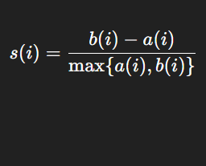
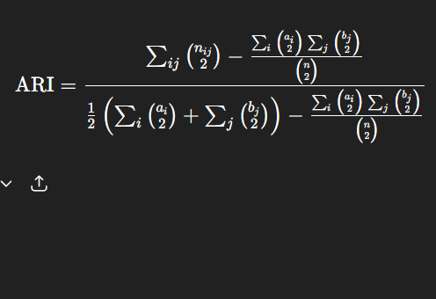
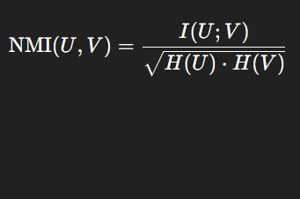
Silhouette score
Tells how well each point fits in its cluster, higher means better fit.
Adjusted Rand Index
Compares your clusters to true labels to see how well they match.
Normalized Mutual Information
Measures how much your clusters and the true labels share information.
Performance Metrics

Slide 9

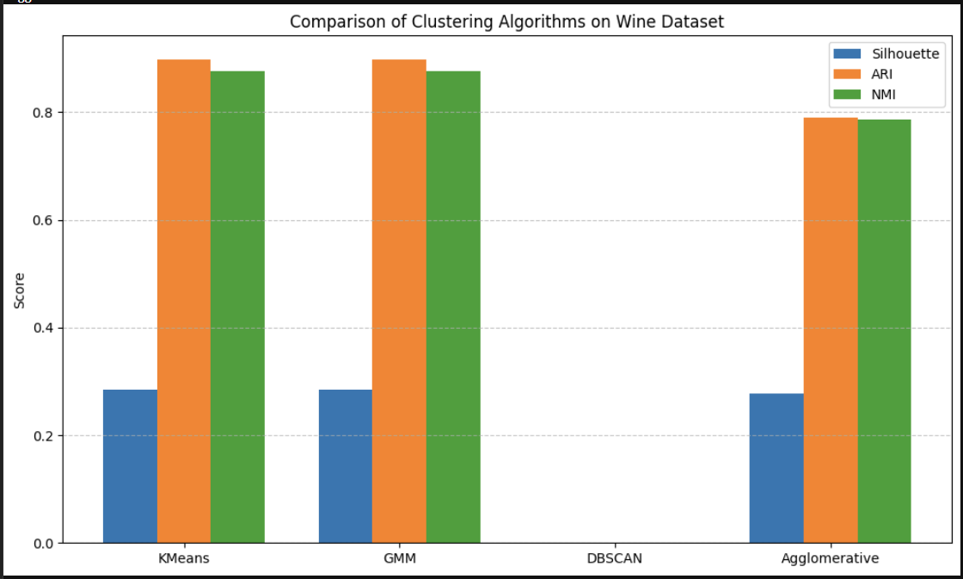
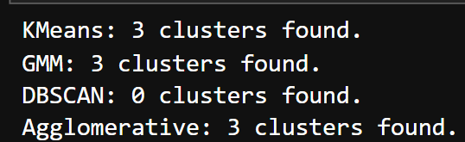
Each dataset tells its own story.

Slide 10
Explainability Metrics
Coverage
How much of the clustered data is explainable?
Comprehensibility
Is the explanation simple enough to follow?
Fidelity
Does the explanation match the original clustering labels?
Stability
Does the explanation remain consistent across runs?

Slide 11
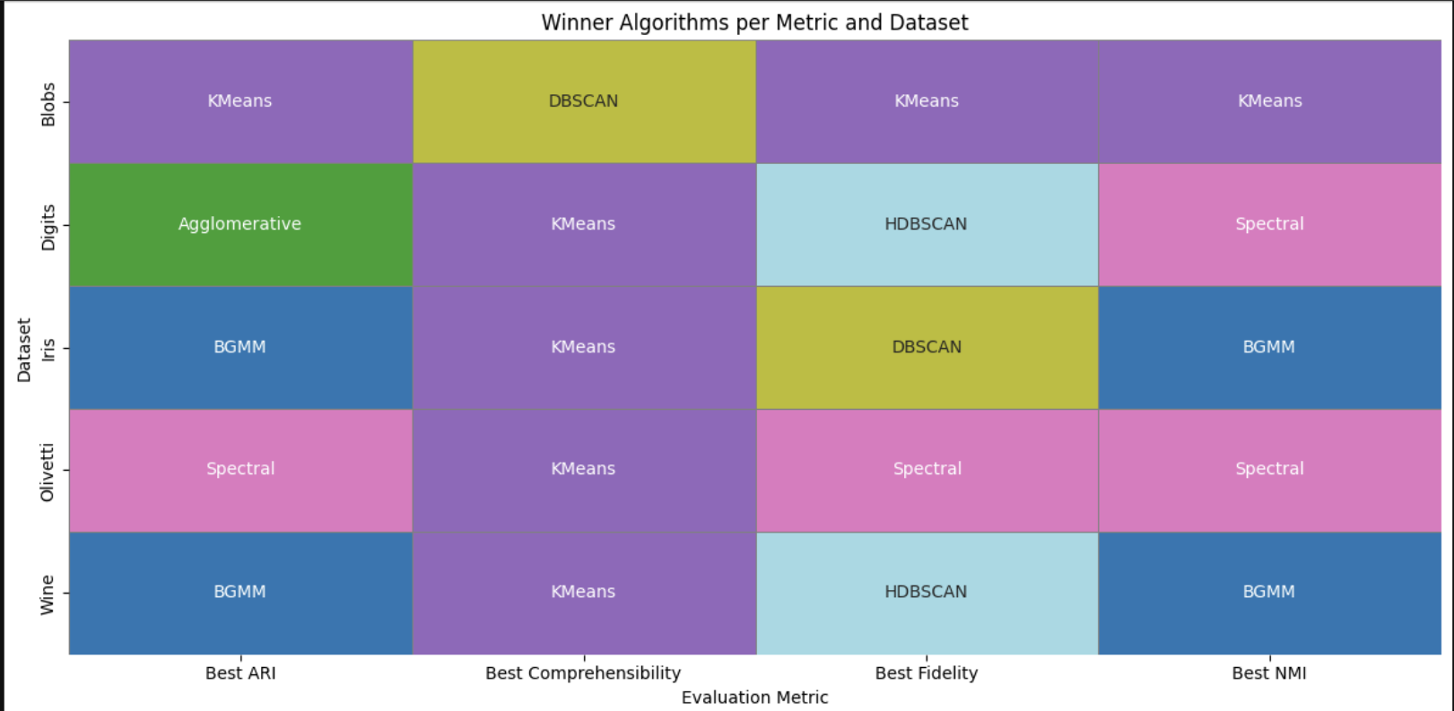
+88%
Elaborate on the statistic here.
+400k
Elaborate on the statistic here.
-12%
Elaborate on the statistic here.

Slide 12
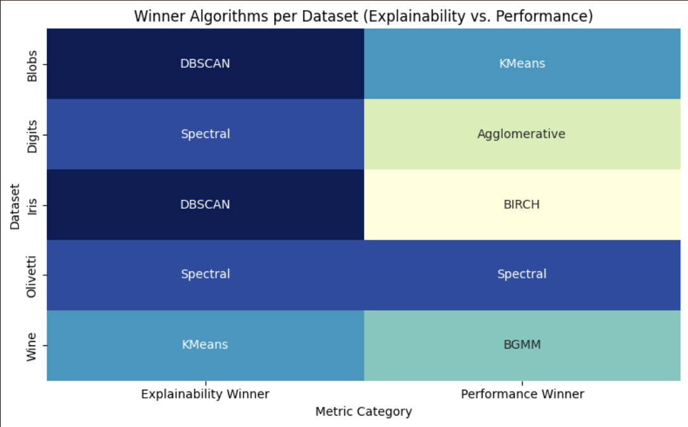




Overall Analysis
John Doe
position
Jane Doe
position
John Doe
position

Slide 13
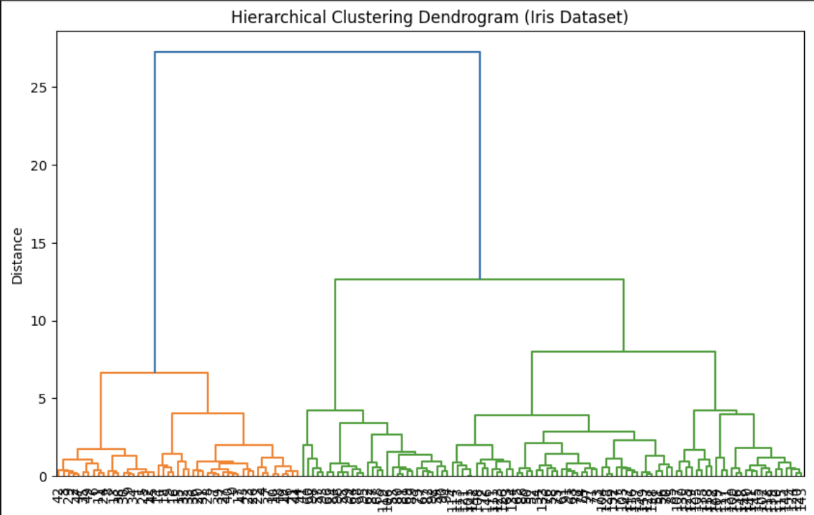
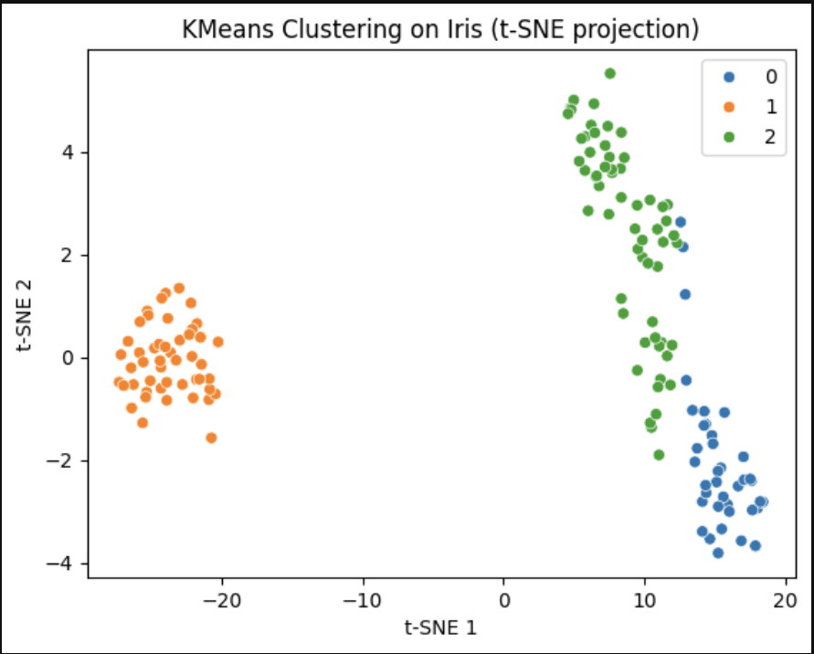
How do I explain this to non-tech folks?

Slide 14






Special Thanks to
Lead Actors
Kmeans, Spectral, HDBSCAN, GMM
Supporting Cast
DBSCAN,
Agglomerative,
MiniBatch KMeans
Cinematography
t-SNE & PCA
Critics
Silhouette, ARI,
NMI, Fidelity
Script Consultants
Iris, Wine,
Digits, Olivetti Faces
Explainability Department
Coverage, Stability, Comprehensibility

Slide 15

Survey Paper and Code Repository

